Slide 1
Title
Name
Hospital

Slide 2
Introduce yourself
Notes:
Grab the participants’ attention in the first few seconds
Start your presentation with a personal message, like telling about your family, home town or more work related.

Slide 3
Menu
Bullet points only allowed here
Key topic 2
Key topic 3
Notes:
Repeat, repeat, repeat

Slide 4
Key topic 1
Notes:
Restrict yourself to 3 key points

Slide 5
ExampleExae Example:
Case presentation
Case presentation
Notes:
Use plenty of pictures

Slide 6
Example:
Your questions to this patient?
Role-Play:
Participants =
the patient’s doctor
Notes:
Repeat, repeat, repeat
Methods: case presentation, role-play, metaphors, storytelling, voting, … = be creative

Slide 7
Key topic 2
Notes:
Use plenty of pictures

Slide 8
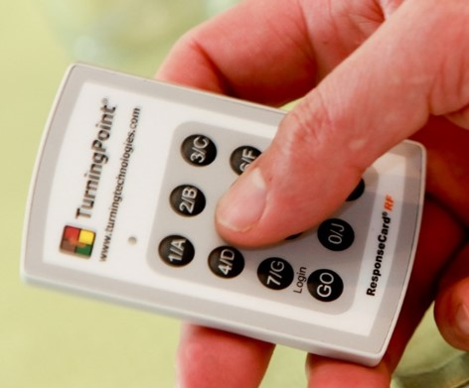
Voting question: …
Up to 9 different answers
Indicate the right answer (if there is one)
More than 1 right answer possible
…
…
…
…
…
…
Notes:
Repeat, repeat, repeat
Voting question = closed question

Slide 9
Key topic 3
Notes:
Use plenty of pictures

Slide 10
Voting question: …
Up to 9 different answers
Indicate the right answer (if there is one)
More than 1 right answer possible
…
…
…
…
…
…
Notes:
Repeat, repeat, repeat

Slide 11
Discussion
Notes:
Make the participants work

Slide 12
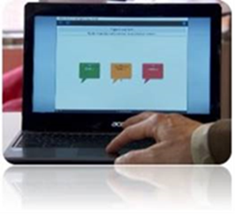
Discussion:
What have you learned?
OR
Discuss most important learning points?
OR
Where & how will you apply, what you have learned?
3 examples:
choose 1
OR
create your own
Notes:
Make the participants work
Open question = start with What, Where or How...?

Slide 13
Summary
Bullet points only allowed here
Key take-away
Key take-away
Notes:
Repeat, repeat, repeat

Slide 14
Contact details
Notes:
Maximum of 20 slides = more is less

